Slide 1

Mental Health
in the
Work Environment
Medical Treatment Dataset
John Mintsa, Nathan Magno, Kiet Nguyen, Kierra Manuel

Slide 2
Agenda
Introduction
Decision Tree & Random Forest
Logistic Regression & Ensemble Method
Neural Network
Boosted Trees and Support Vector for Machines
Conclusion

Slide 3
Background
As workplace burnout, fatigue levels rise, and individuals increasingly leave their jobs due to toxic workplace cultures for the sake of their mental health, addressing mental health issues in the workplace has become a critical concern.
In response to this growing challenge, our project focuses on evaluating and identifying the most effective model for classifying whether participants require mental health treatment.
We aim to achieve this by leveraging a comprehensive Medical Treatment Dataset.

Slide 4
Our Dataset
Dataset Overview:
28 Categorical Attributes and 1 Numerical Attribute (Age)
Balance Dataset (48.3% Need Treatment and 51.7% DO NOT Need Treatment)
Comprehensive information related to mental health
Includes variables such as self-employment, family history of mental illness, and perceptions of employer support
Target Variable:
Prediction target is “Treatment” variable
Objective:
Facilitates the evaluation of different models for accurate classification of individuals who may require health treatment.

Slide 5
Decision Tree & Random Forest

Slide 6
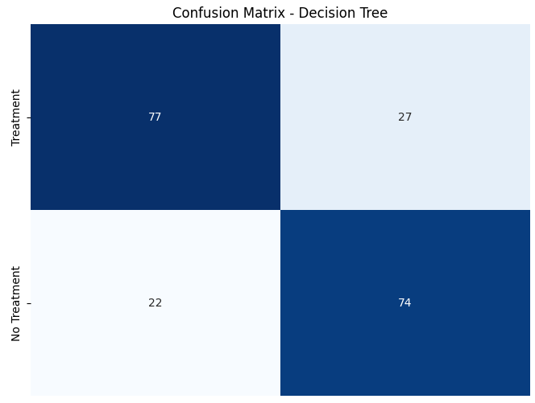
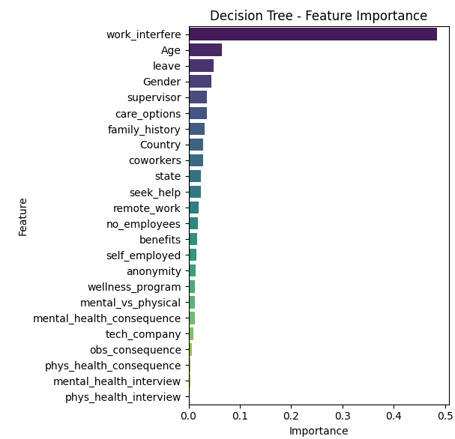
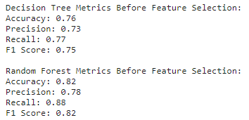
Decision Tree
Notes:
The decision tree model achieved a 76% overall accuracy, with a focus on 'work_interfere' as a key factor in predicting mental health treatment necessity.

Slide 7
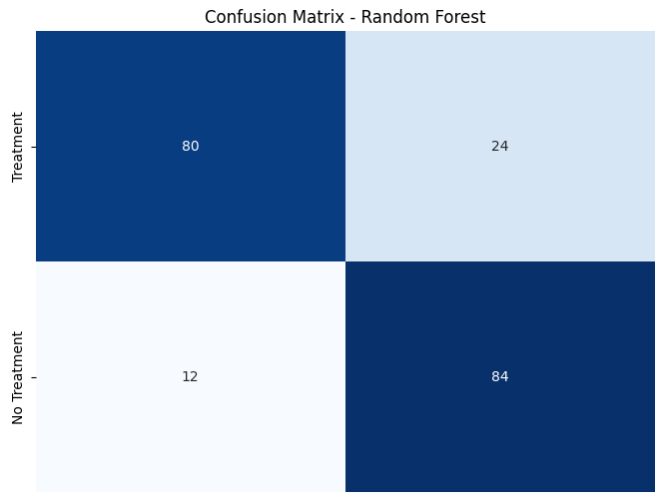
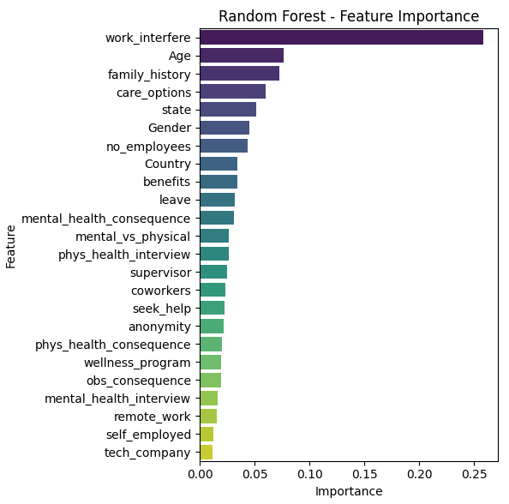
Random Forest
Notes:
The random forest model achieved a 82% overall accuracy, with a focus on 'work_interfere' and ‘age’ as key factors in predicting mental health treatment necessity.

Slide 8
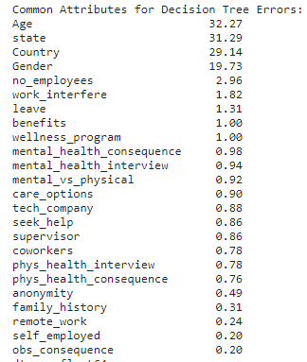
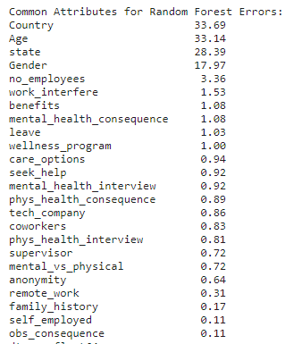
Error Analysis For Decision Tree & RF
While there are minimal difference between the two models, DT is more influenced by age and state, and RR is more influenced by country and age.

Slide 9
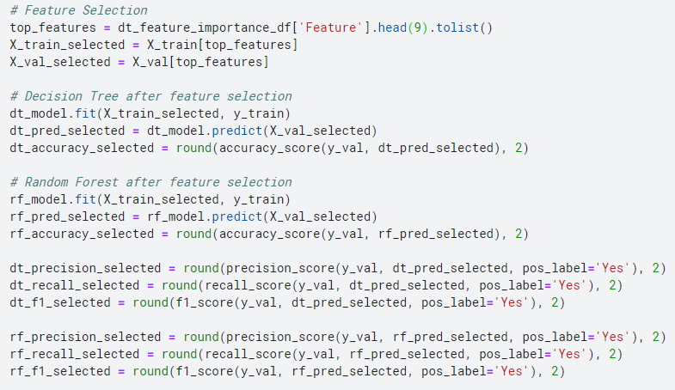
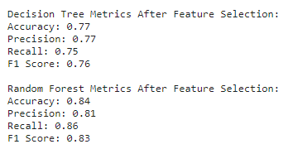
Decision Tree & RF Accuracy Improvement

Slide 10
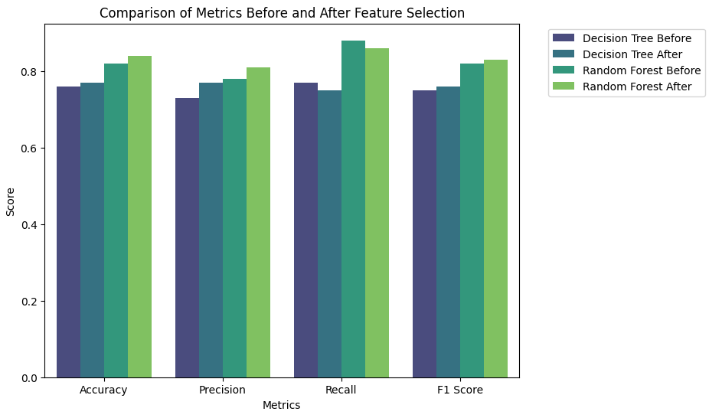
Decision Tree & RF Accuracy Improvement Result
Feature selection led to improvements in accuracy and precision for both models.
Decision Tree showed a small decrease in recall after feature selection, suggesting a potential trade-off between precision and recall.
Random Forest sees improvements in accuracy, precision, and F1 score after feature selection, with a slight decrease in recall.
Notes:
These changes suggest that feature selection had a positive impact on model performance, particularly in terms of accuracy and precision, but there might be a slight compromise in recall for the Decision Tree model. The Random Forest model, on the other hand, demonstrated improvements across multiple metrics.

Slide 11
Logistic Regression &
Ensemble Method

Slide 12
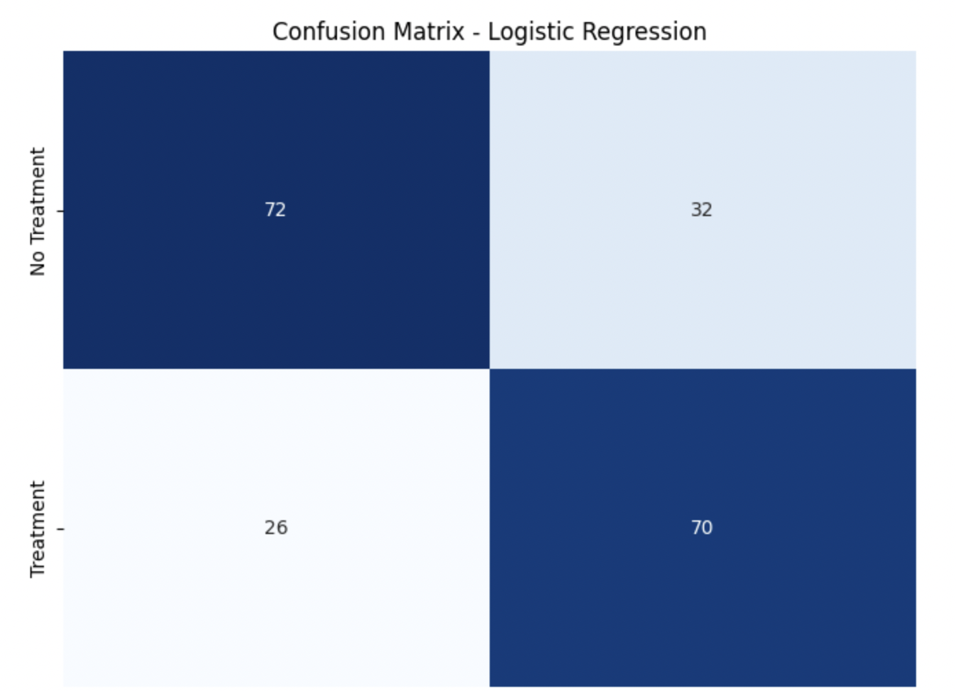
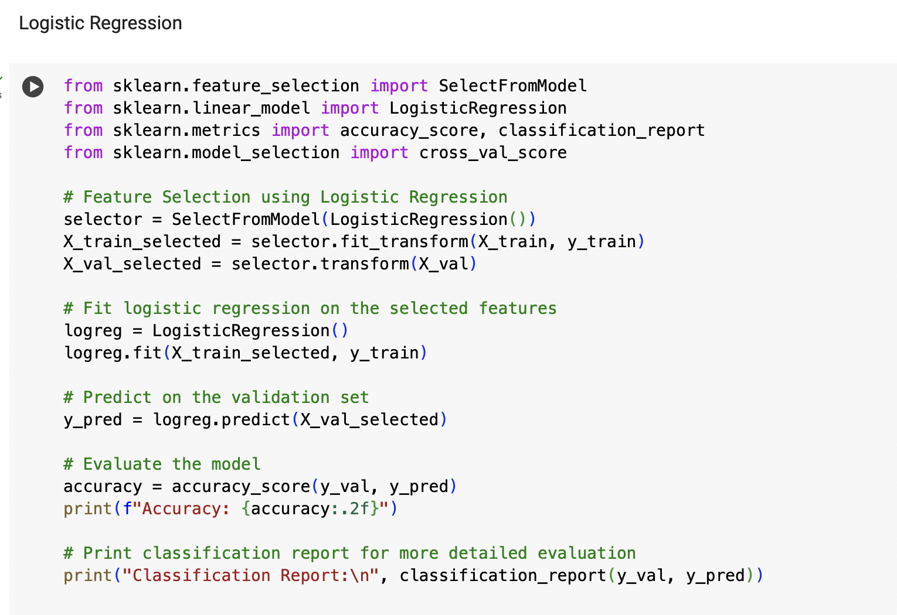
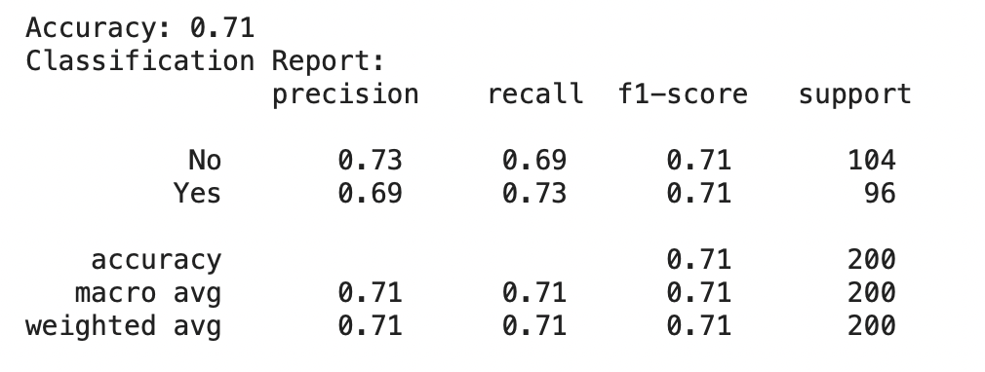
Logistic Regression

Slide 13
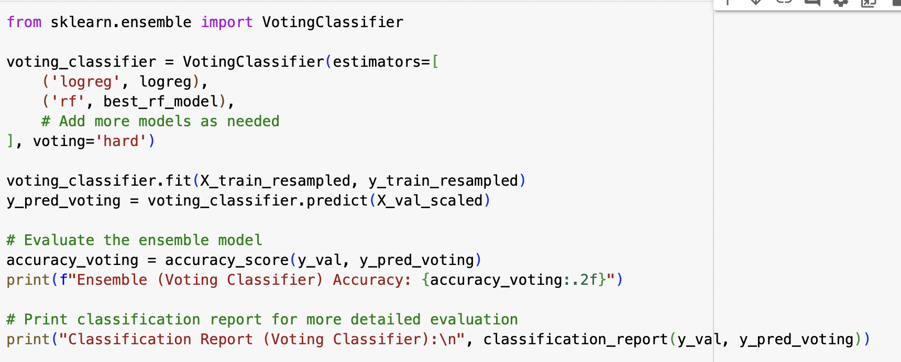
Logistic Regression Accuracy Improvements
Ensemble method (Voting Classifier)
Logistic Regression and Random Forest Models
Overall accuracy improved from 71% to 79%
Ensemble method uses the strengths of the individual models for a more comprehensive and accurate prediction mechanism
The results demonstrate effectiveness of mitigating limitations of standalone models

Slide 14
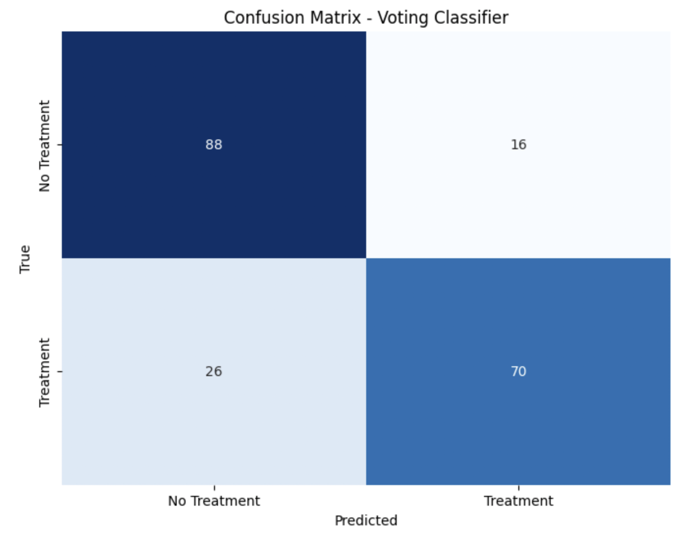
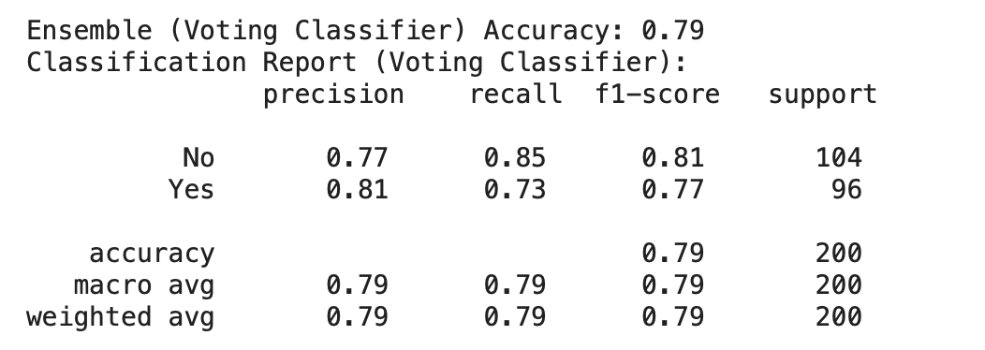
Accuracy Improvement Results

Slide 15
Neural Network

Slide 16
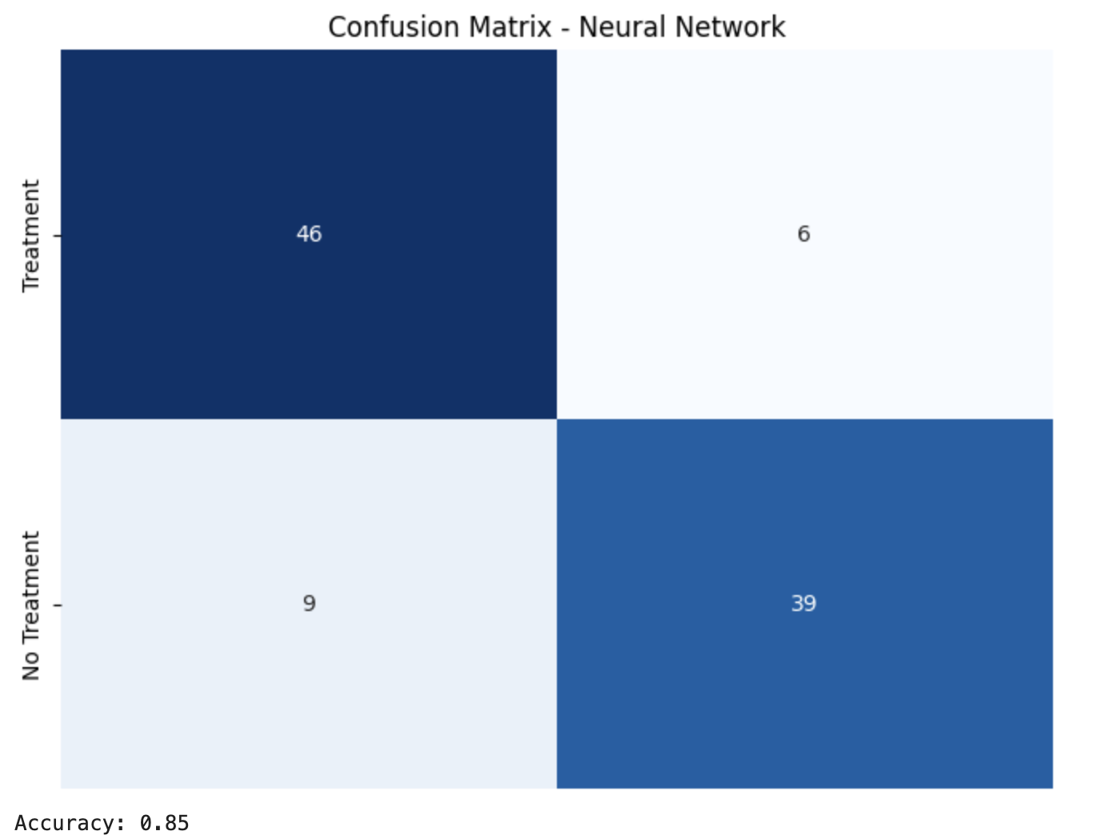
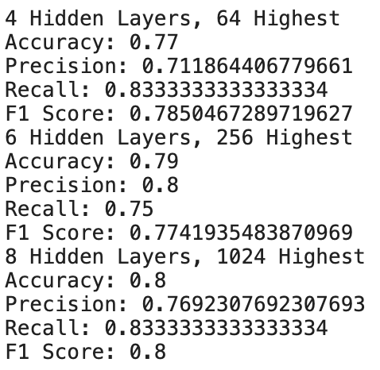
Neural Network

Slide 17
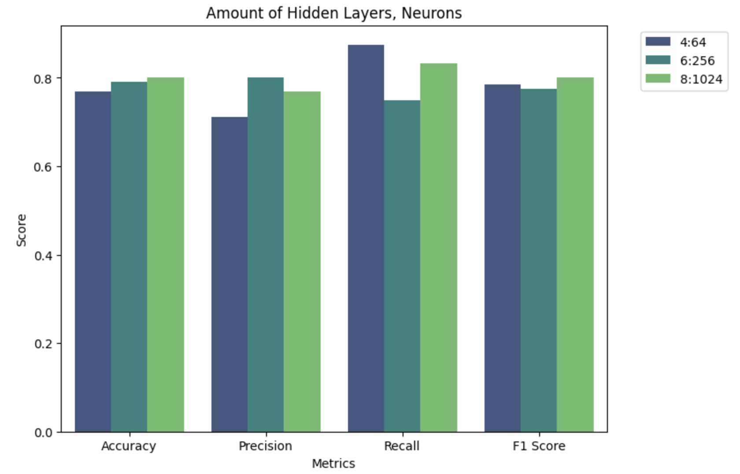
Hidden Layer Analysis

Slide 18
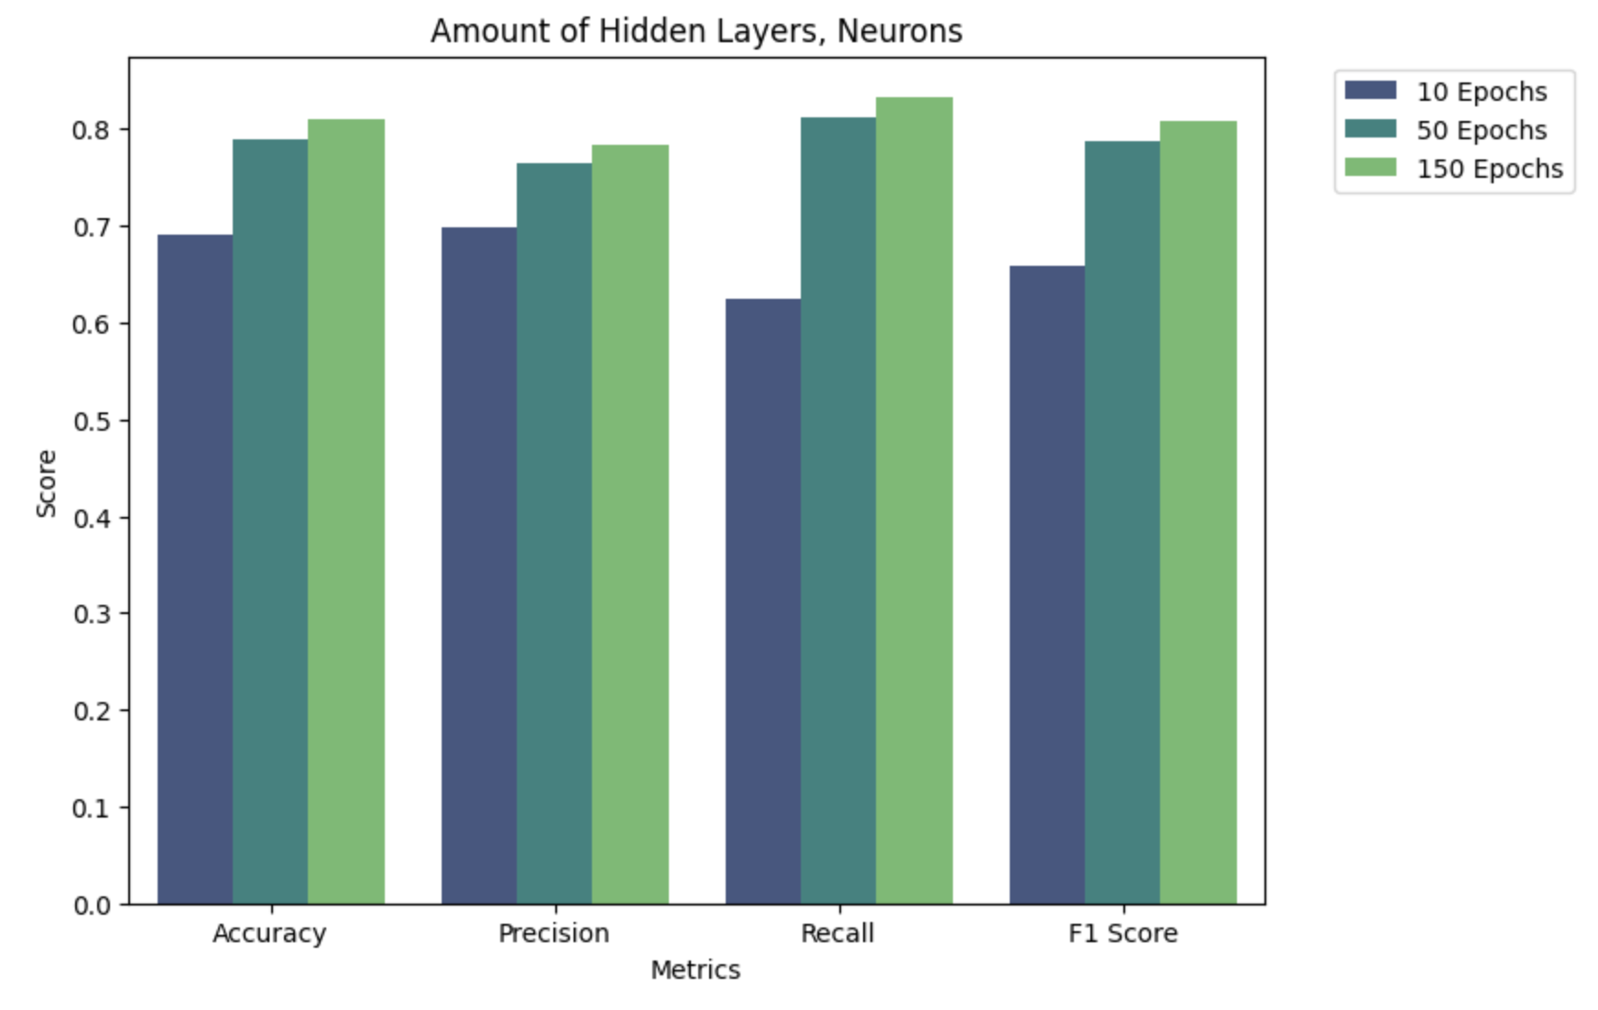
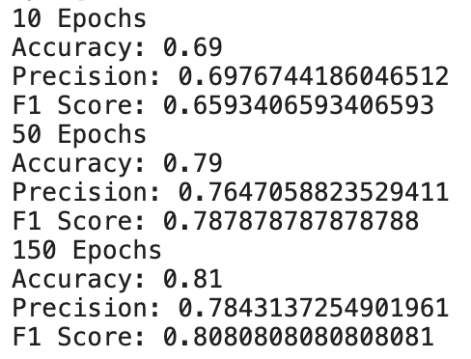
Epoch Analysis

Slide 19
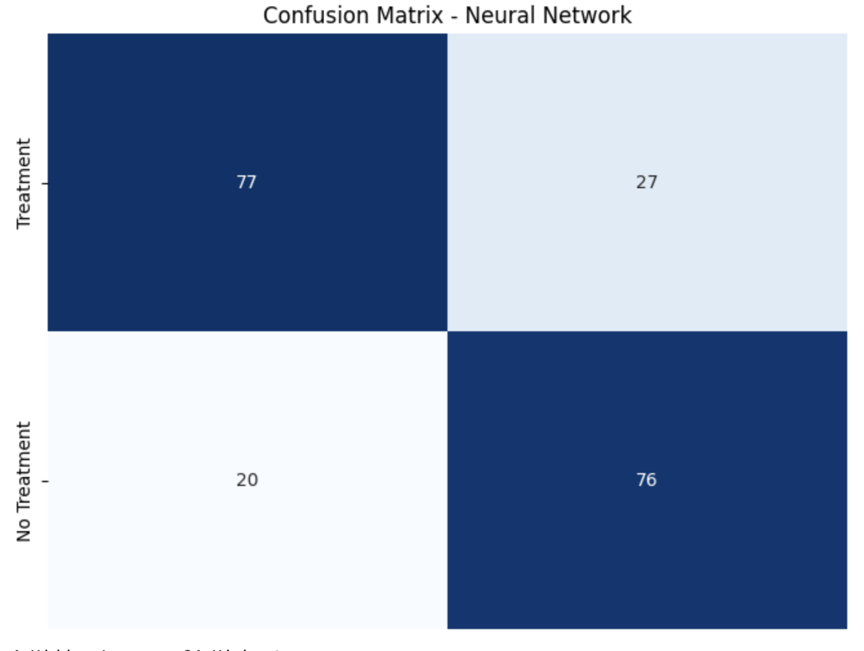
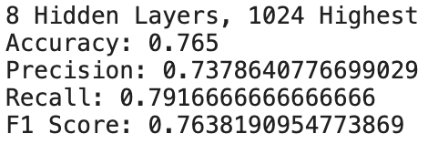
Altering Train/Test Split

Slide 20
Boosted Trees and Support Vector for machines

Slide 21
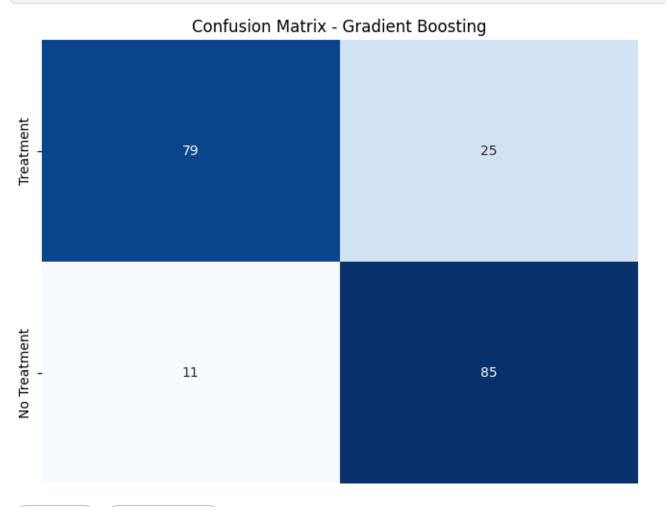
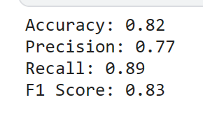
Gradient Boosting

Slide 22
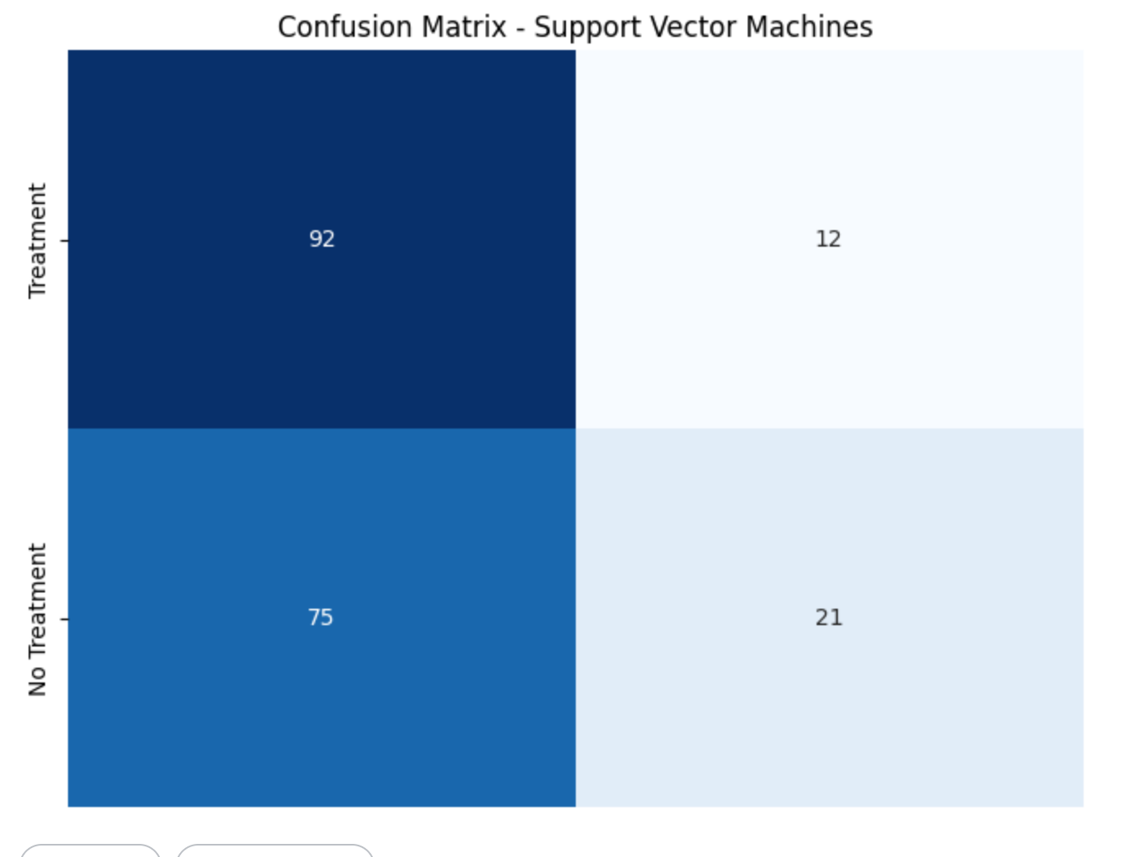
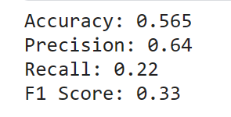
Support Vector for machines

Slide 23
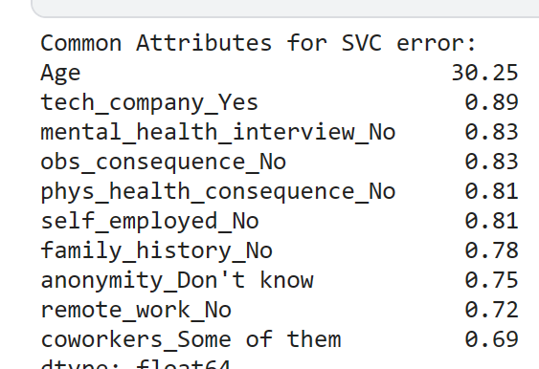
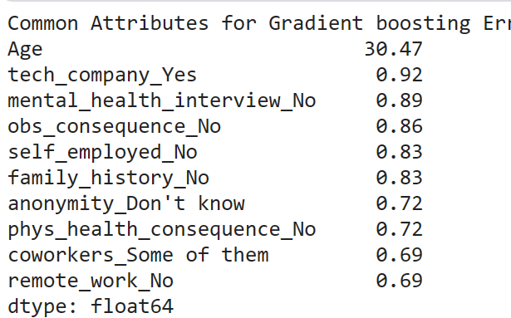
Error analysis for gradient error and Support Vector for machines
The two models are
Similar. They are both heavily influence by the age.

Slide 24
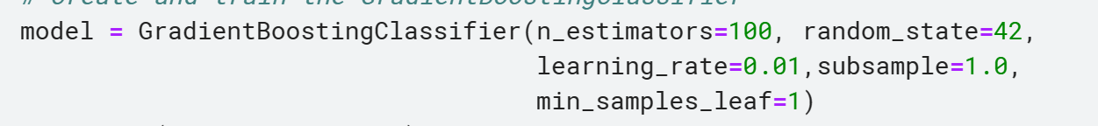
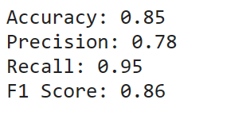
Improvement on boosting trees
We change the learning rate multiple times and deciding to set it to 0.01

Slide 25

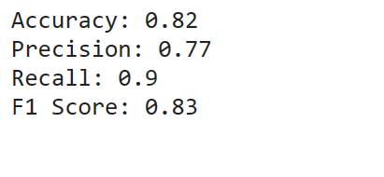
Improvement on SVC
After changing the kernel from rbf to linear we obtained much better results.

Slide 26
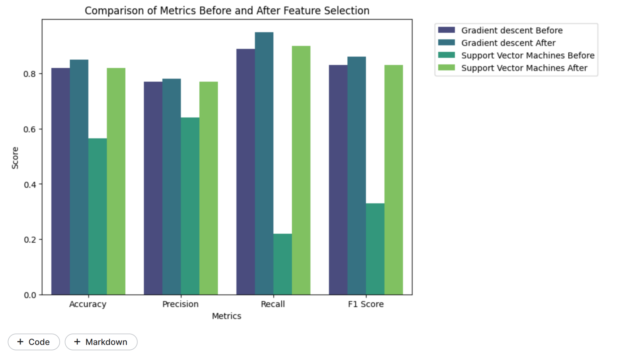
Boosting Tree and Support Vector Machines
We can see that after changing the learning
Rate our model becomes more efficient.
Also the charge in the algorithm use is
Important. SVC’s accuracy went from around
50% to 80%, when changing the algorithm from
Rbf to linear

Slide 27
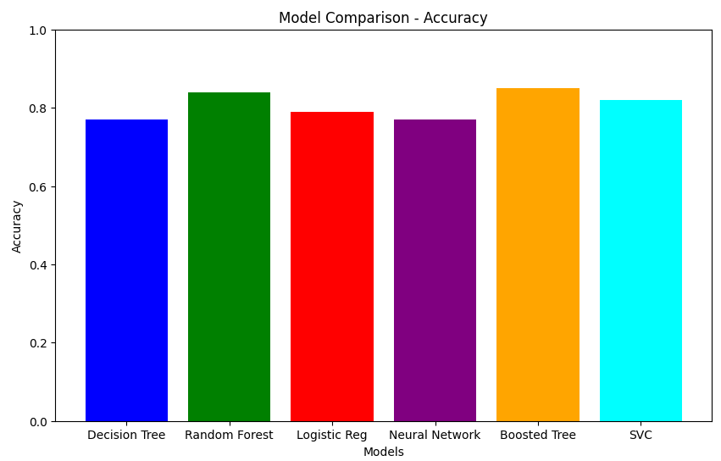
Conclusion
Notes:
The bar chart illustrates that the Boosted Tree model outperforms other models, achieving the highest accuracy of 0.85, while Random Forest and Support Vector Classifier also demonstrate strong performance compared to Decision Tree, Logistic Regression, and Neural Network models.

